Slide 1

INTERNET OF THINGS
Chapter4: Connecting Smart Objects
Dr. Nagegowda K S
Department of Computer Science & Engineering

Slide 2
INTERNET OF THINGS
Agenda
Communication Criteria
IoT Access Technologies

Slide 3
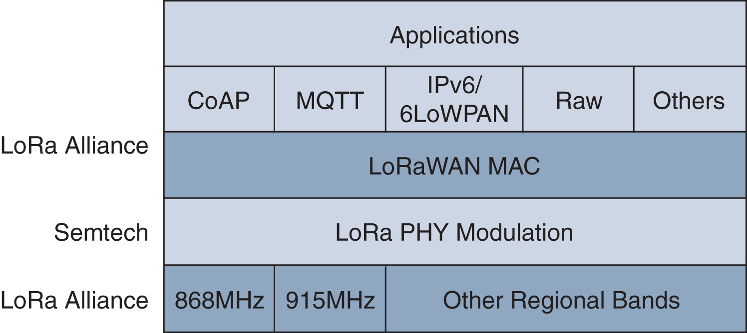
INTERNET OF THINGS
IoT Access Technologies- LoRaWAN Layers

Slide 4
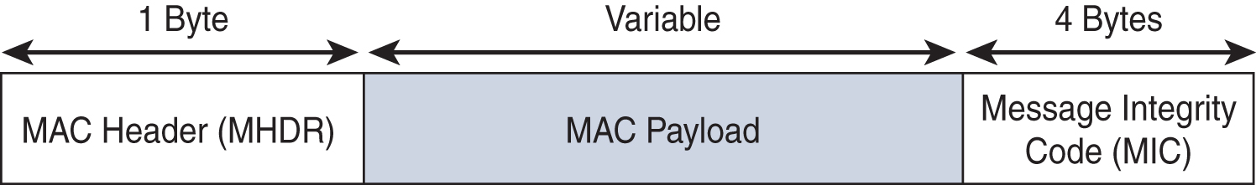
INTERNET OF THINGS
IoT Access Technologies- LoRaWAN
Figure - High-Level LoRaWAN MAC Frame Format

Slide 5
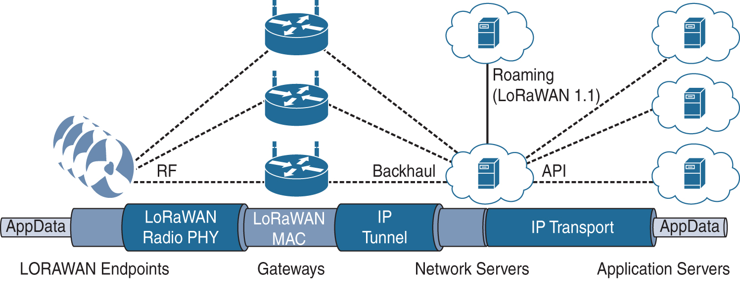
INTERNET OF THINGS
IoT Access Technologies- LoRaWAN Architecture

Slide 6
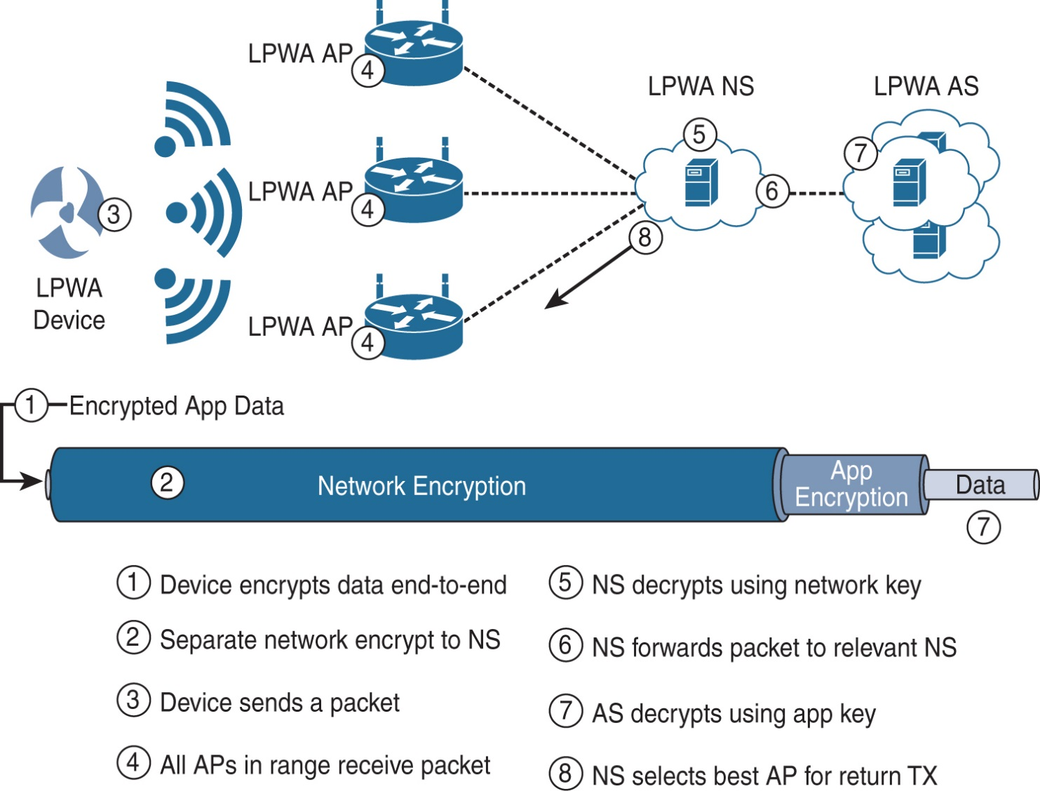
INTERNET OF THINGS
IoT Access Technologies- LoRaWAN Security

Slide 7
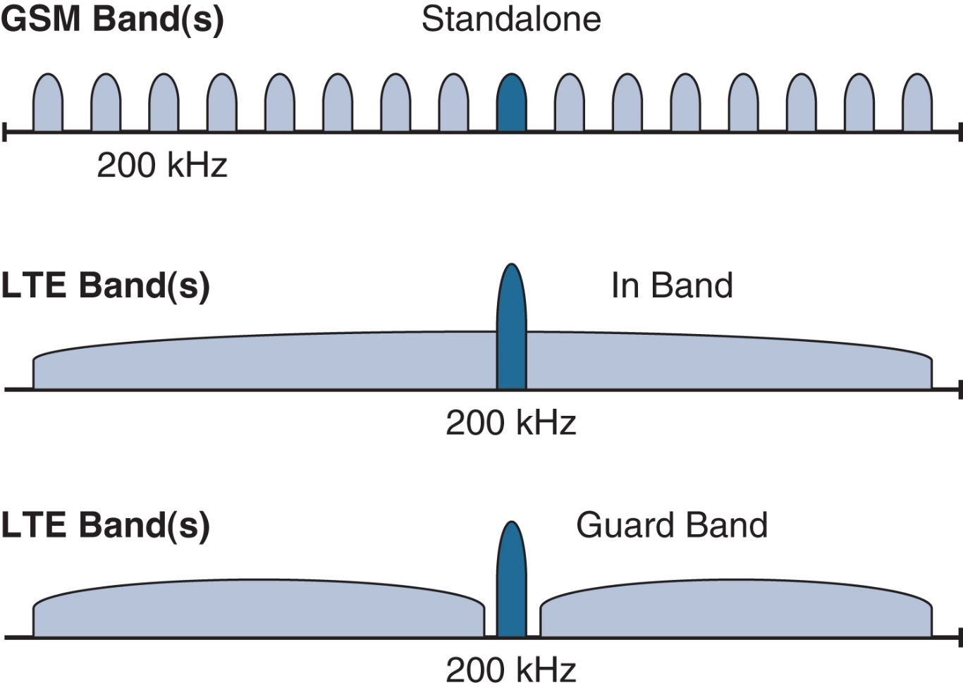
INTERNET OF THINGS
IoT Access Technologies- NB-IoT Deployment Options

Slide 8

THANK YOU
Dr. Nagegowda K S
Department of Computer Science & Engineering
nagegowda@pes.edu

